Slide 1

Security
Computer System Engineering, Fall 2018. (IPADS, SJTU)
Authentication & Secure Channel
Yubin Xia

Slide 2
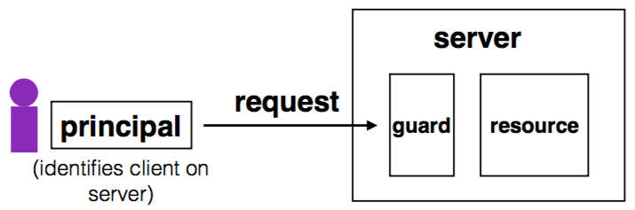
Review: Complete Mediation
Guard typically provides:
Authentication: is the principal who they claim to be?
Authorization: does principal have access to perform request on resource?

Slide 3
Review: Designing the Guard
Two functions often provided by a guard:
Authentication: request -> principal
E.g., client's username, verified using password
Authorization: (request, principal, resource) -> allow?
E.g., consult access control list (ACL) for resource
Simplifies security
Can consider the guards under threat model
But don't forget about complete mediation

Slide 4
Example: Unix FS
Resource: files, directories.
Server: OS kernel.
Client: process.
Requests: read, write system calls.
Mediation: U/K bit / system call implementation.
Principal: user ID.
Authentication: kernel keeps track of user ID for each process.
Authorization: permission bits & owner uid in each file's inode.

Slide 5
Bypassing Complete Mediation
All ways to access resource must be checked by guard
Common estimate: one bug per 1,000 lines of code
Adversary may trick server code to do something unintended, bypass guard
How to prevent bypassing?
Reduce complexity: reduce lines of code
The "principle of least privilege"

Slide 6
Example: Paymaxx.com (2005)
https://my.paymaxx.com/
Requires username and password
If you authenticate, provides menu of options
One option is to get a PDF of the tax form
https://my.paymaxx.com/get-w2.cgi?id=1234
Gets a PDF of W2 tax form for ID 1234
get-w2.cgi forgot to check authorization
Attacker manually constructs URLs to fetch all data

Slide 7
Example: SQL Injection
username | email | public?
matei | matei@sjtu.edu.cn | yes
mike | mcarbin@sjtu.edu.cn | yes
katrina | lacurts@sjtu.edu.cn | no
SELECT username, email FROM users WHERE
username='<username>' AND public='yes'
Let <username> = katrina' OR username='
SELECT username, email FROM users WHERE
username='katrina' OR username='' AND
public='yes'

Slide 8
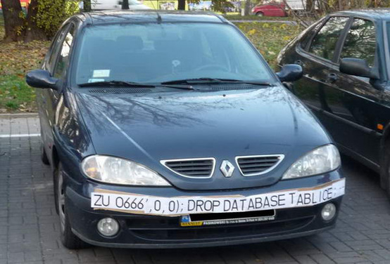
SQL Injection
ZU 0666',0,0);; DROP DATABASE TABLICE;

Slide 9
Authentication

Slide 10
Principle of Least Privilege
Deal with bugs / incomplete mediation
Any component that can arbitrarily access a resource must invoke the guard
If component has a bug or design mistake, can lead to incomplete mediation
General plan: reduce the number of components that must invoke the guard
E.g., arrange for DB server to check permissions on records returned, then security does not depend as much on lookup.cgi

Slide 11
Security Jargon: Trust
Privileged components are "trusted"
Trusted is bad: you are in trouble if a trusted component breaks
Untrusted components are good: does not matter if they break
Good design has few trusted components, other things do not affect security

Slide 12
TCB of Xen (A Hypervisor)
Control VM
Tools
Guest
VM
Kernel
VMM
[Colp, SOSP'11]
Trusted Computing Base
TCB: Trust Computing Base
9 Million for virtualization stack
Becomes the single point of failure
Xen has around 200 security bugs (2016)

Slide 13
Policy vs. Mechanism
High-level policy is (ideally) concise and clear
Security mechanisms (e.g., guards) often provide lower-level guarantees
E.g., policy is that students cannot get a copy of exam.txt
What should the permissions on the files be?
What should the firewall rules be?
Good idea: try to line up security mechanisms with desired policies

Slide 14
Interactions between Layers, Components
cse-srv% cd /2012f/bob/project
cse-srv% cat ideas.txt
Hello world.
…
cse-srv% mail alice@sjtu.edu.cn < ideas.txt
cse-srv%
Bob changes ideas.txt into a symbolic link
to CSE's exam.txt

Slide 15
Users Make Mistakes
Social engineering, phishing attacks
How many of you really read the permission acquired by apps during installing?
Good idea: threat model should not assume users are perfect

Slide 16
Cost of Security
Security VS. Availability
E.g., system requires frequent password changes -> users may write them down
How far should a teacher go to protect the exam file?
Put the file on a separate computer, to avoid sharing a file system?
Disconnect computer from the network, to avoid remotely exploitable OS bugs?
Put the server into a separate machine room?
Get a guard to physically protect the machine room?
...
Good idea: cost of security mechanism should be commensurate with value
Notes:
Most security goals/policies not infinitely valuable, can tolerate attacks.
Security mechanisms can be expensive (e.g., wasted user time).

Slide 17
Case: Password

Slide 18
Authentication: Password
Password goals
Authenticate user
Adversary must guess
For random 8-letter passwords, ~26⁸?
Guessing is expensive

Slide 19
An Example: Guessing Password
checkpw (user, passwd):
acct = accounts[user]
for i in range(0, len(acct.pw)):
if acct.pw[i] ≠ passwd[i]:
return False
return True
passwd:
P
A
S
S
W
O
R
D
X
acct.pw:
P
A
S
S
w
O
R
D

Slide 20
Problem: Guess One Character at a Time
Guess a password
Allocate password 1 byte away from a page boundary
Page-fault means first char is OK
Example of cross-layer interactions
Problem: server has a copy of all passwords
If adversary exploits buffer overflow, can get a copy of all passwords

Slide 21
Timing Attack: Guess One Character at a Time
Guess a password
Allocate password 1 byte away from a page boundary
Page-fault means first char is OK
Example of cross-layer interactions
Also known as "Timing Attack"

Slide 22
Timing Attack: Guess One Character at a Time
Page in Memory
a
b
c
ca
…
cs
…
Page on Disk -> Page Fault
aaaaaaa
aaaaaaa
aaaaaaa
aaaaaa
aaaaaa
Time = 1ms
Time = 1ms
Time = 10ms
Time = 1ms
Time = 10ms
Page Fault!
The 1st char is 'c'
Page Fault!
The 2nd char is 's'

Slide 23
Idea: Store Hash of Password
Hash functions: arbitrary strings to fixed-length output
Common output sizes are 160 bits, 256 bits, ..
One-way: given H(x), hard to recover x
Collision-resistant: hard to find different x and y such that H(x)=H(y)
Evolve over time: SHA-0 and MD-5 used to be popular, now considered broken

Slide 24
Store Hash of Password
Accounts database stores hash of every user's password
Compute hash, check if the hash matches
Solves not only the password theft problem, but also the page-fault attack

Slide 25
Store Hash of Password
username | hash(password) arya | de5aba604c340e1965bb27d7a4c4ba03f4798ac7
jon | 321196d4a6ff137202191489895e58c29475ccab
Sansa | 6ea7c2b3e08a3d19fee5766cf9fc51680b267e9f
hodor | c6447b82fbb4b8e7dbcf2d28a4d7372f5dc32687
check_password(username, inputted_password):
stored_hash = accounts_table[username]
inputted_hash = hash(inputted_password)
return stored_hash == inputted_hash

Slide 26
Store Hash of Password
What happens if an adversary breaks into a popular web site with 1M accounts?
Adversary steals 1M hashes
Problem: adversary can guess each password one-by-one
Problem: worse yet, adversary can build table of hashes for common passwords
Often called a "rainbow table"
Users are not great at choosing passwords, many common choices

Slide 27
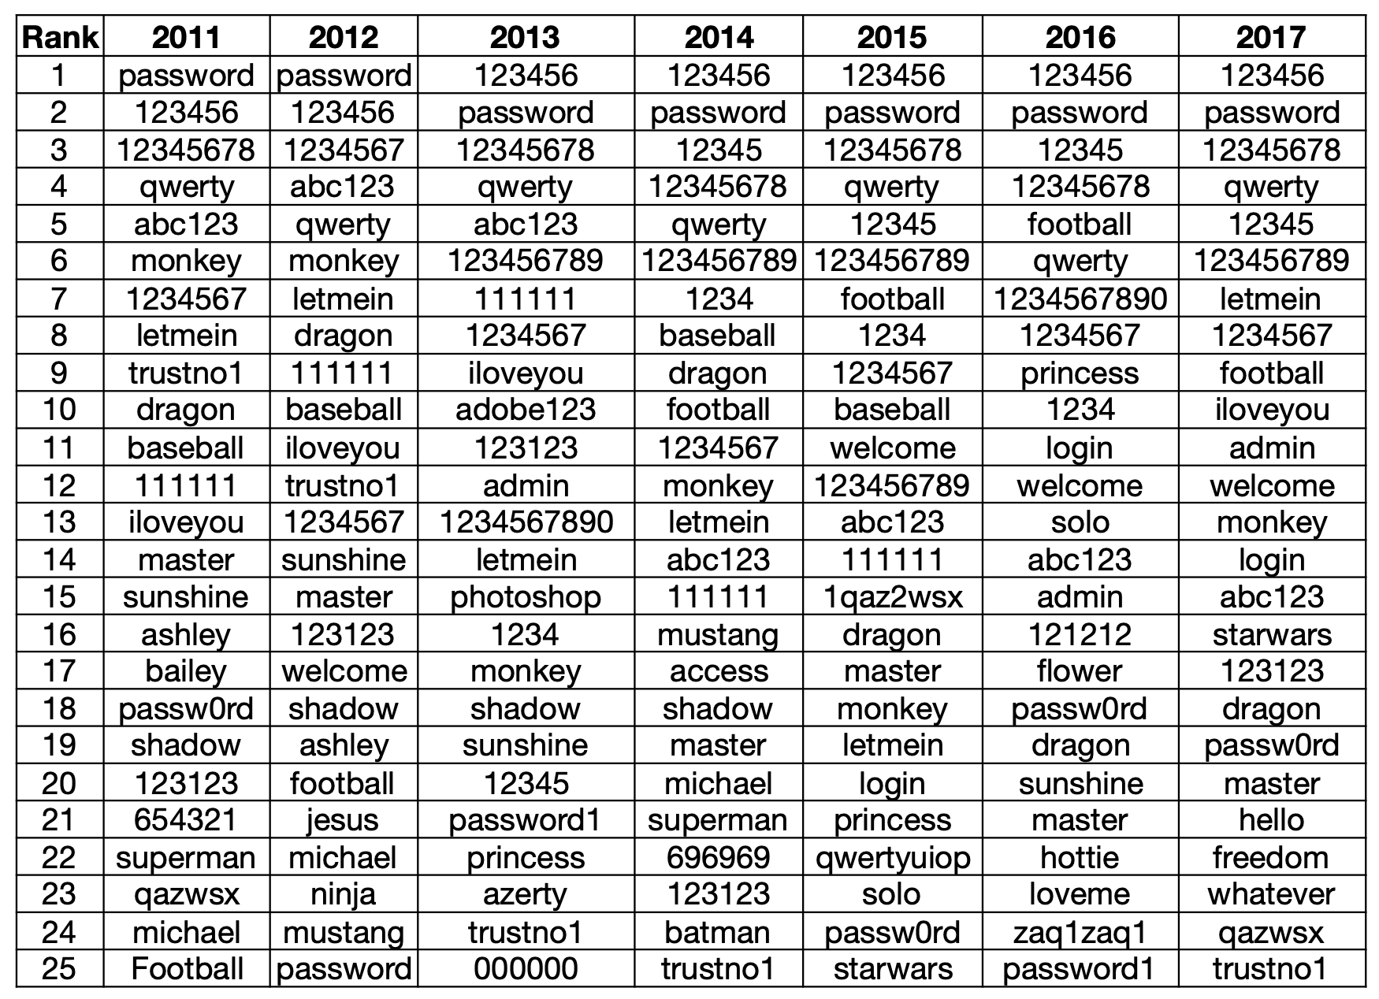

Slide 28
Store Hash of Password
Important to think of human factors when designing security systems
Not much we can do for users that chose "123456"
Plenty of bad passwords have numbers, uppercase, lowercase, etc.
What matters is the (un)popularity of a password, not letters/symbols
But we can still make it a bit harder to guess less-embarrassing passwords

Slide 29
Salting
Salting: make the same password have different hash values
Makes it harder to build a pre-defined lookup table
Choose random salt value when storing the password (& store the salt)
Store hash of salt and password together
Use the original salt to compute a matching hash when verifying password
Every password has many possible hash values -> impractical to build rainbow table
Use a much more expensive hash function
For reference: look up "bcrypt" by Provos and Mazieres

Slide 30
Salting
username | salt | hash(password | salt)
arya | 5334900209 | c5d2a9ffd6052a27e6183d60321c44c58c3c26cc
jon | 1128628774 | 624f0ffa577011e5704bdf0760435c6ca69336db
Sansa | 8188708254 | 5ee2b8effce270183ef0f4c7d458b1ed95c0cce5
Hodor | 6209415273 | f7e17e61376f16ca23560915b578d923d86e0319
check_password(username, inputted_password)
stored_hash = accounts_table[username]
inputted_hash = hash(inputted_password | salt)
return stored_hash == inputted_hash

Slide 31
Bootstrap Authentication
Do not want to continuously authenticate with password for every command
Typing, storing, transmitting, checking password: risk of compromise
In Unix login:
Login process exchanges password for userid
In web applications:
Often exchange password for a session cookie
Can think of it as a temporary password that's good for limited time

Slide 32
Session Cookies: Strawman
First check username and password, if ok, send:
Use the tuple to authenticate user for a period of time
Nice property: no need to store password in memory, or re-enter it often
Server_key is there to ensure users can't fabricate hash themselves
Arbitrary secret string on server, can be changed (invalidating cookies)
Can verify that the username and expiration time is valid by checking hash
{username, expiration, H(server_key | username | expiration)}

Slide 33
Session Cookies: Strawman
Problem: the same hash can be used for different username/expiration pairs!
E.g., "Ben" and "22-May-2012" may also be "Ben2" and "2-May-2012"
Concatenated string used to compute the hash is same in both cases!
Can impersonate someone with a similar username
Principle: be explicit and unambiguous when it comes to security
E.g., use an invertible delimiter scheme for hashing several parts together

Slide 34
Phishing Attacks
Adversary tricks user into visiting legitimate-looking web site (e.g., bank)
Asks for username/passwd
Actually a different server operated by adversary
E.g., bank0famerica.com instead of bankofamerica.com
Stores any username/passwd entered by victims
Adversary can now impersonate victims on the real web site

Slide 35

Key Problem of Password
Key problem: once you send a password to the server, it can impersonate you
Solved part of the problem by hashing the password database
But still sending the password to the server to verify on login

Slide 36
Technique 1: challenge-response scheme
Challenge-response
Server chooses a random value R, sends it to client
Client computes H(R + password) and sends to server
Server checks if this matches its computation of hash with expected password
If the server did not already know password, still does not know (to defend against phishing)

Slide 37
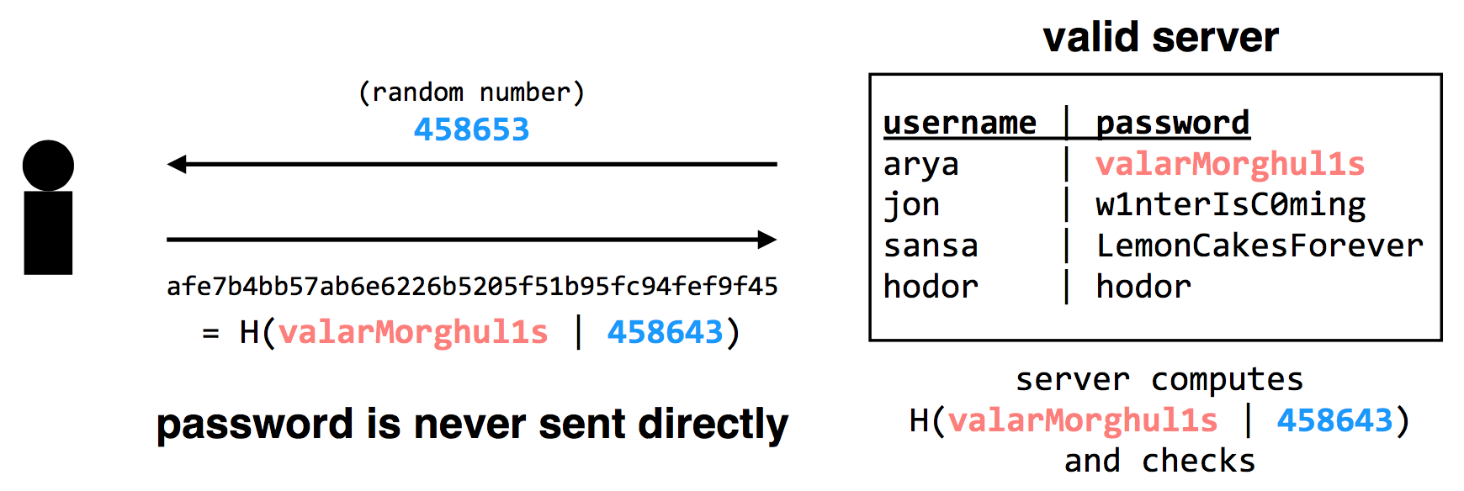
Technique 1: challenge-response scheme
Adversary only learns H(valarMorghul1s | 458643); can not recover the password from that

Slide 38
Tech 2: use passwords to authenticate the server
Make the server prove it knows your password
Client chooses Q, sends to server, server computes H(Q + password), replies
Only the authentic server would know your password!
Unfortunately, not many systems use this in practice
In part because app developers just care about app authenticating user..
Notes:
Slight problem: simple challenge-response can't be used with hashed passwords.
Need the original password to compute hash together with random challenge.
If we store the hashed password, its hash now becomes the effective password..
There's a protocol that allows both.
Store a "hash" of password, challenge-response auth.
Look up "SRP" if building a real system (details too complicated for 6.033).

Slide 39
Tech 2: use passwords to authenticate the server
Complication: could be used with first scheme to fool server!
First, try to log into the server: get the server's challenge R
Then, decide you want to test the server: send it the same R
Send server's reply back to it as response to the original challenge
Principle: be explicit, again!
E.g., hash the intended recipient of response (e.g., client or server), and have the recipient verify it
Notes:
Slight problem: simple challenge-response can't be used with hashed passwords.
Need the original password to compute hash together with random challenge.
If we store the hashed password, its hash now becomes the effective password..
There's a protocol that allows both.
Store a "hash" of password, challenge-response auth.
Look up "SRP" if building a real system (details too complicated for 6.033).

Slide 40
Tech 3: turn offline into online attack
Turn phishing attacks from offline into online attacks
If adversary doesn't have the right image, users will know the site is fake
Adversary could talk to real site, fetch image for each user that logs in

Slide 41
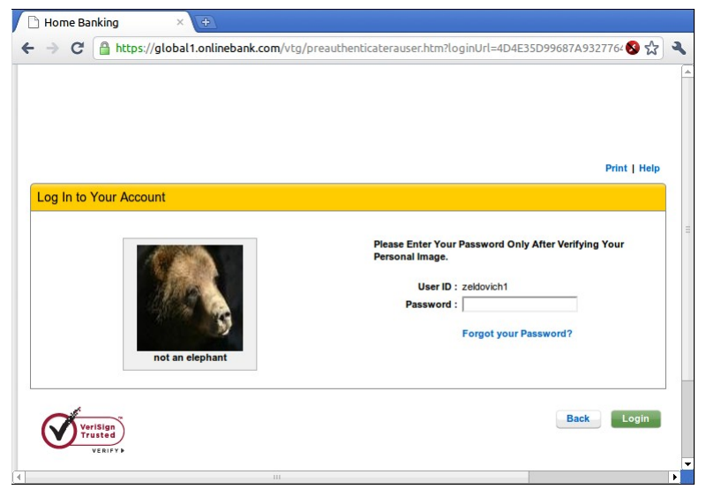
"Sitekey"

Slide 42
Tech 3: turn offline into online attack
Why is it still useful, then?
Requires more efforts on adversary's part to mount attack
Even if adversary does this, bank can detect it
Watch for many requests coming from a single computer
That computer might be trying to impersonate site
Turns an offline/passive attack into an online/active attack
Key insight
Don't need perfect security, small improvements can help

Slide 43
Tech 4: Specific password
Make passwords specific to a site.
Instead of sending password, send H(servername + password).
Just like a basic password scheme, from the server's point of view.
Except impersonator on another server gets diff passwd.
Recommendation
E.g., LastPass

Slide 44
Tech 5: one-time passwords
One-time Password
If adversary intercepts password, can keep using it over and over
Can implement one-time passwords: need to use a different password every time
Design: construct a long chain of hashes.
Start with password and salt, as before.
Repeatedly apply hash, n times, to get n passwords.
Server stores x = H(H(H(H(...(H(salt+password)))))) = H^{n}(salt+password)
To authenticate, send token=H^{{n-1}}(salt+password).
Server verifies that x = H(token), then sets x <- token
User carries a printout of a few hashes, or uses smartphone to compute them.

Slide 45
Tech 5: one-time passwords
Alternative design: include time in the hash (Google's 2-step verification)
Server and user's smartphone share some secret string K.
To authenticate, smartphone computes H(K || current time).
User sends hash value to server, server can check a few recent time values.

Slide 46
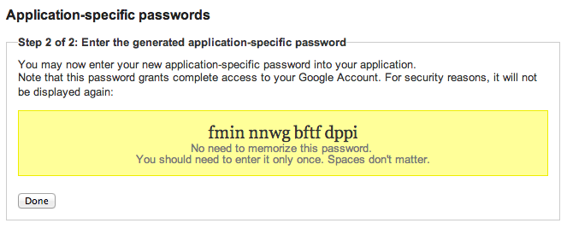

Google's App-specific password

Slide 47
Tech 6: bind authentication and request authorization
One way to look at problem: sending password authorizes any request
even requests by adversary that intercepts our password
A different design: use password to authenticate any request
req = { username, "write XX to exam.txt", H(password + "write ..") }
Server can check if this is a legitimate req from user using password
Even if adversary intercepts request, cannot steal/misuse password
In practice, don't want to use password, use some session token instead
Could combine well with one-time passwords

Slide 48
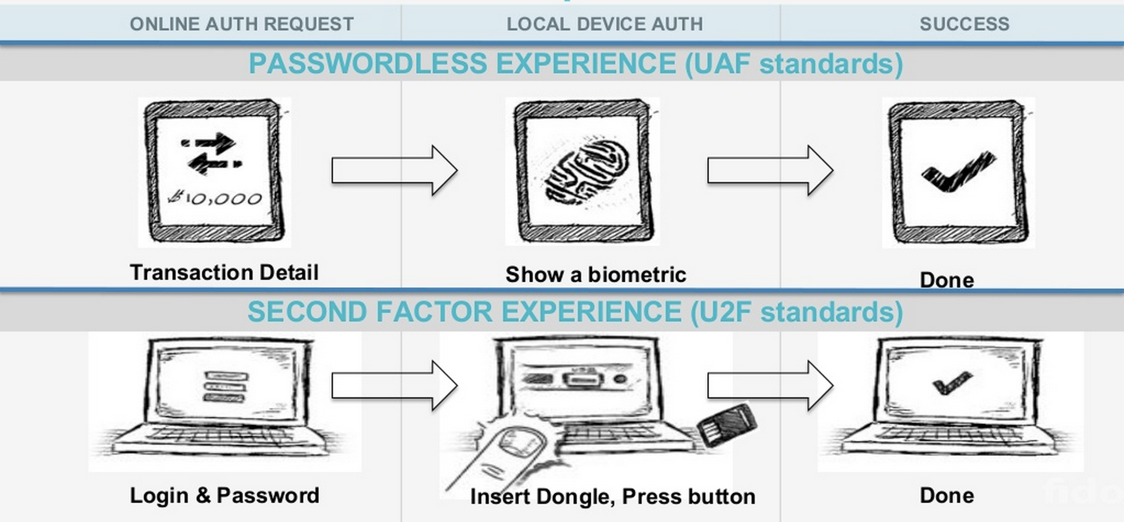
Tech 7: FIDO: Replace the Password

Slide 49
Three Bindings
Fingerprint
User ID
Private key
Publish key
Phone
Server
Secure by hardware (e.g., TrustZone)
Secure by isolation

Slide 50
Bootstrapping
How to initially set a password for an account?
If adversary can subvert this process, cannot rely on much else.
MIT: admissions office vets each student, hands out account codes.
Many web sites: anyone with an email can create a new account.
Changing password (e.g., after compromise).
Need some additional mechanism to differentiate user vs. attacker.
MIT: walk over to accounts office, show ID, admin can reset password.
Many sites: additional "security" questions used to reset password.
Password bootstrap / reset mechanisms are part of the security system.
Can sometimes be weaker than the password mechanisms.
Sarah Palin's Yahoo account was compromised by guessing security Q's.
Personal information can be easy to find online.

Slide 51
Secure Channel

Slide 52
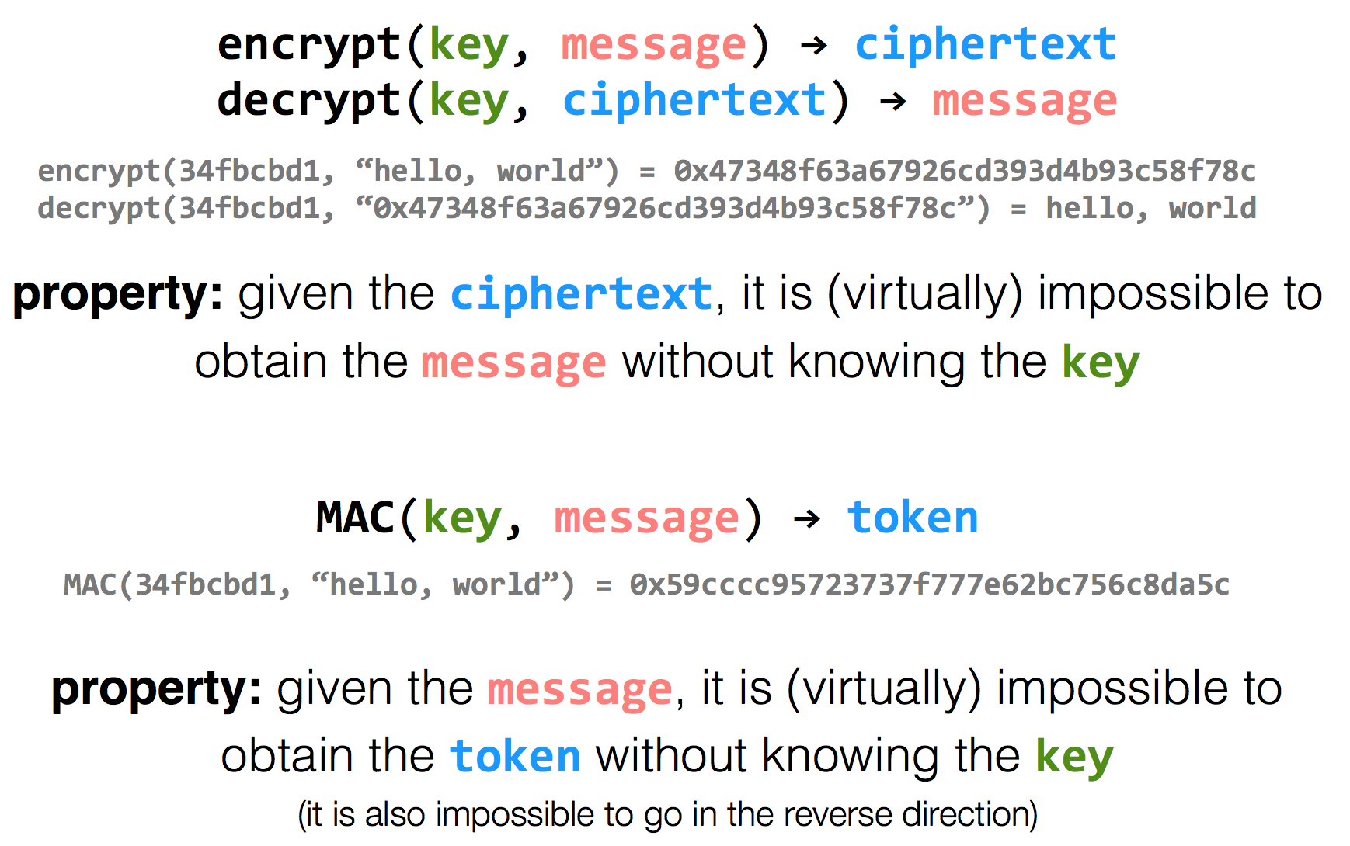
Encryption Properties

Slide 53
k=key
m=message
Alice
Bob
c = encrypt(k, m)
h = MAC(k, m)
c | h
m = decrypt(k, c)
MAC(k, m) == h ?

Slide 54
Alice
Eve
Bob
c = encrypt(k, m)
h = MAC(k, m)
c | h
m = decrypt(k, c)
MAC(k, m) == h ?
c | h
Problem: replay attacks (adversary could intercept a message, re-send it at a later time)
c | h

Slide 55
Alice
Bob
c = encrypt(k, m | seq)
h = MAC(k, m | seq)
c | h
m | seq = decrypt(k, c)
MAC(k, m | seq) == h ?

Slide 56
Alice
Eve
Bob
c = encrypt(k, m | seq)
h = MAC(k, m | seq)
c | h
m | seq = decrypt(k, c)
MAC(k, m | seq) == h ?
c | h
problem: reflection attacks (adversary could intercept a message, re-send it later in the opposite direction)
Notes:
But if receiver is also sending to the sender (i.e., if they're both sending), the receiver might use that sequence number. So adversary could replay in the other direction (a "reflection" attack) - Solution: Use different keys in each direction

Slide 57
Alice
Bob
c_{a} = encrypt(k_{a}, m_{a} | seq_{a})
h_{a} = MAC(k_{a}, m_{a} | seq_{a})
c_{a} | h_{a}
m_{a} | seq_{a} = decrypt(k_{a}, c_{a})
MAC(k_{a}, m_{a} | seq_{a}) == h_{a} ?
c_{b} = encrypt(k_{b}, m_{b} | seq_{b})
h_{b} = MAC(k_{b}, m_{b} | seq_{b})
c_{b} | h_{b}
m_{b} | seq_{b} = decrypt(k_{b}, c_{b})
MAC(k_{b}, m_{b} | seq_{b}) == h_{b} ?

Slide 58
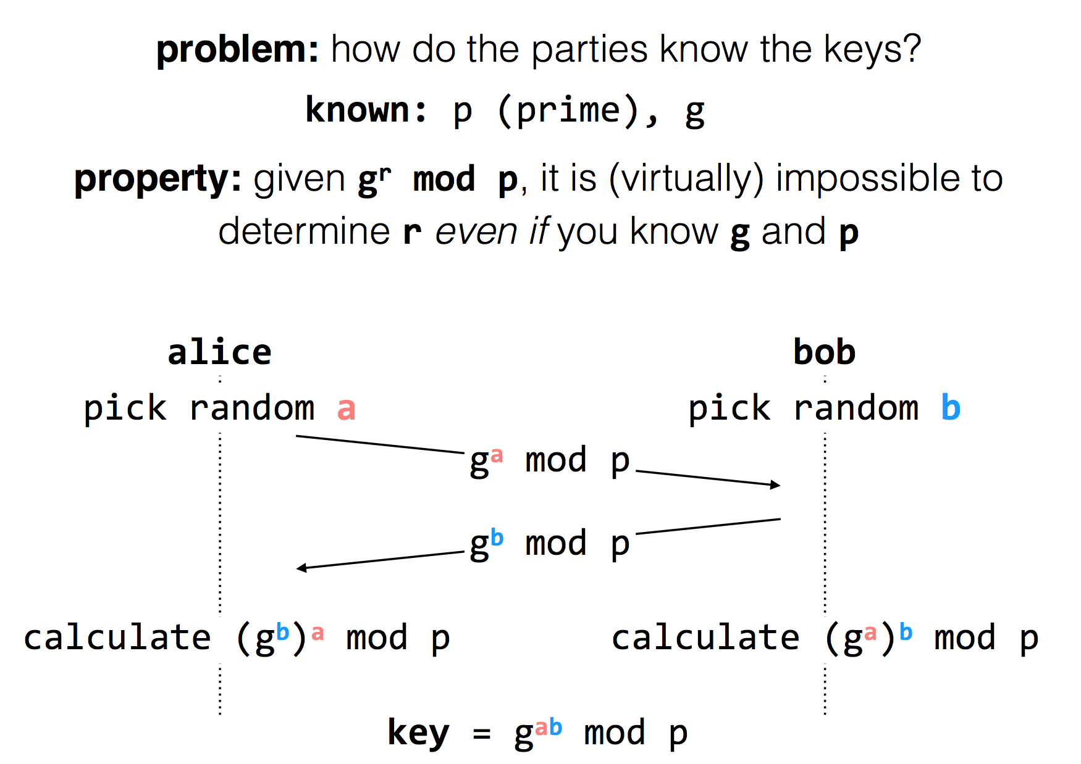
Diffie-Hellman
Key Exchange

Slide 59
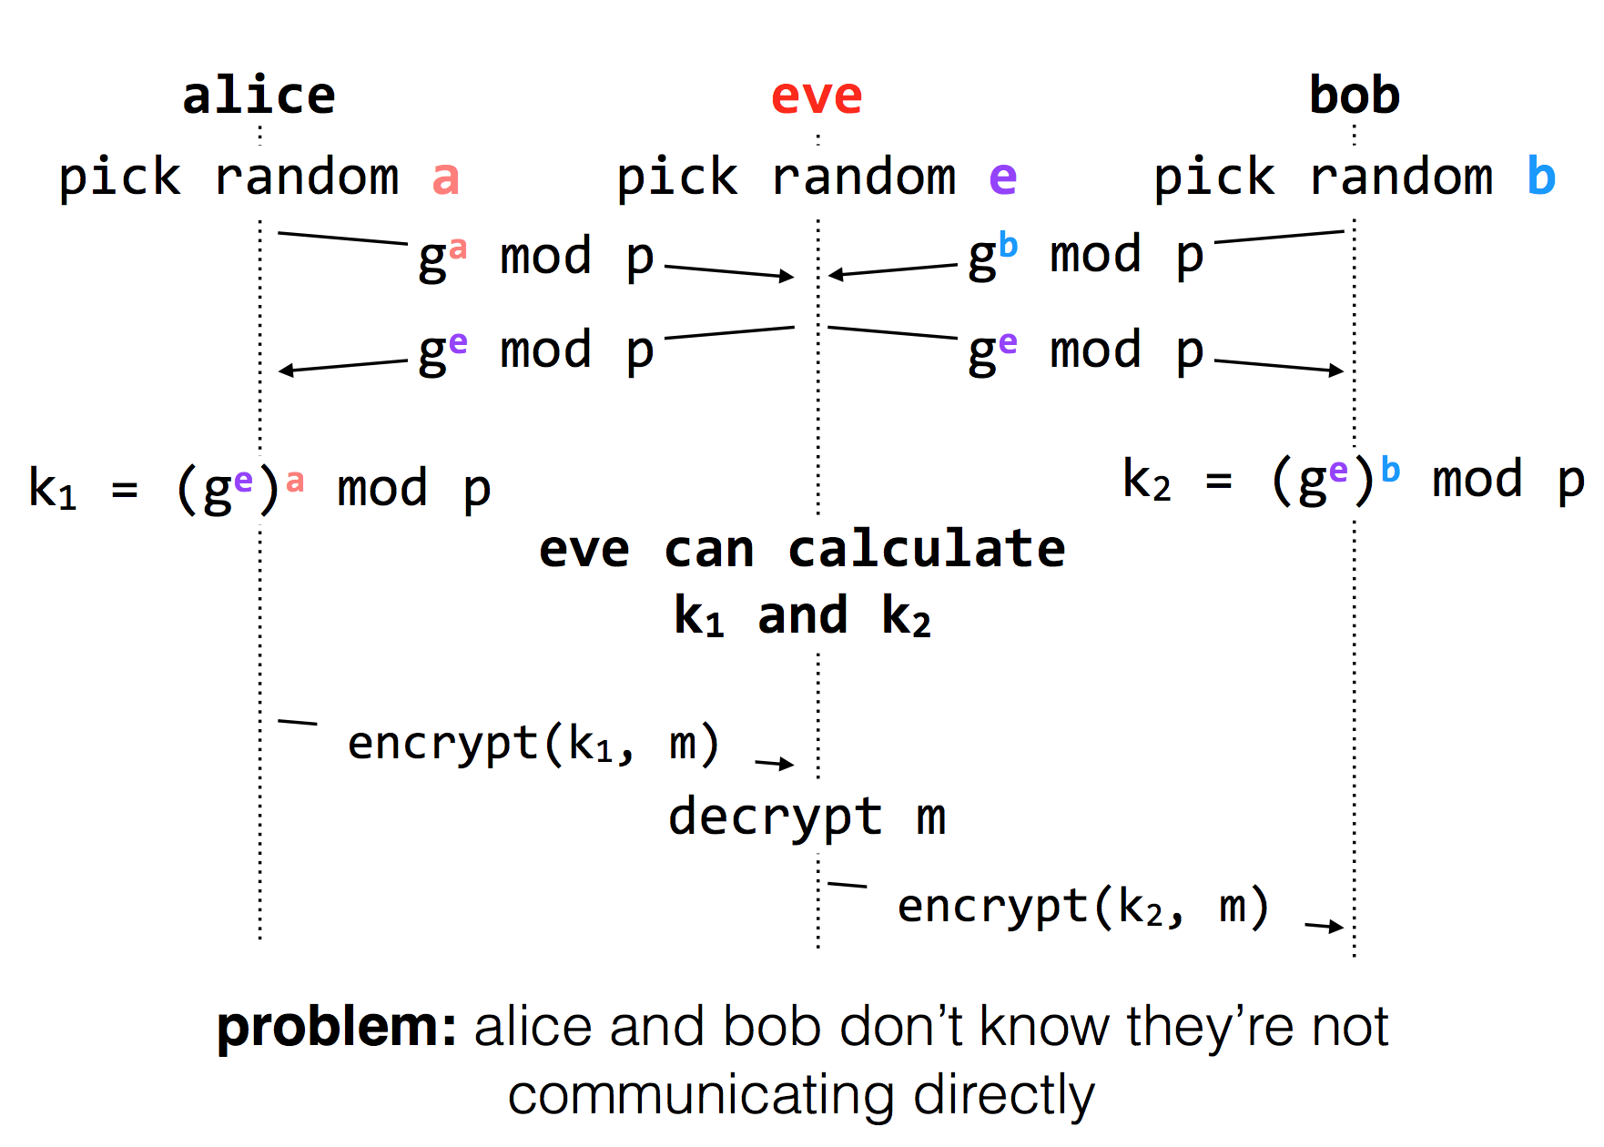
Man-in-the-middle Attack

Slide 60
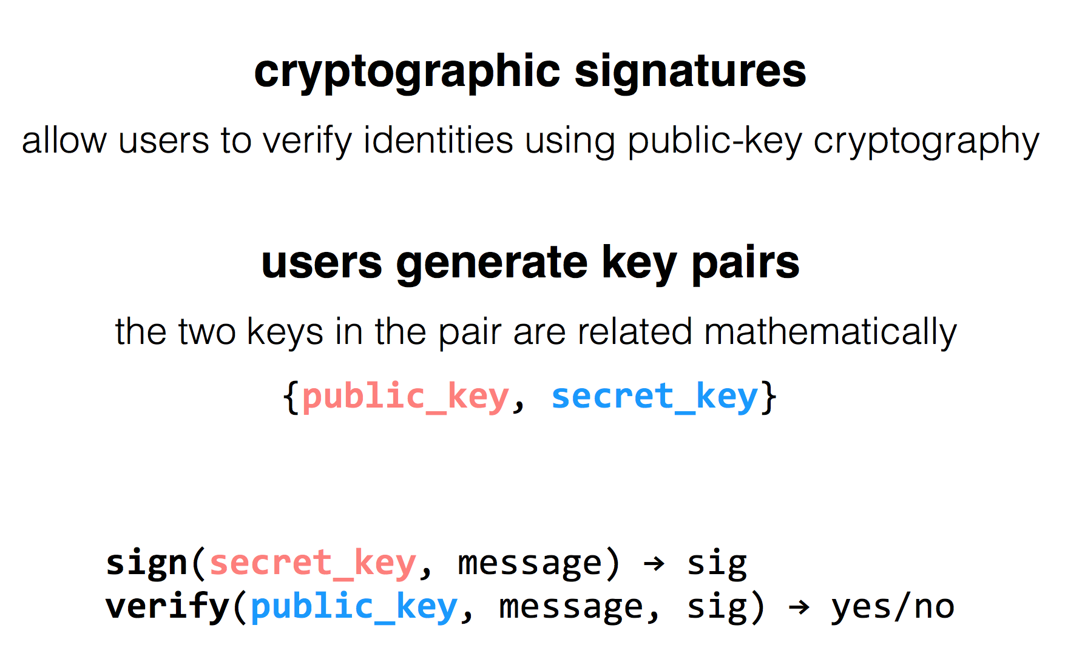
RSA Algorithm

Slide 61
How to Get the Public Key?
1. Alice remembers the key she used last time
Easy to implement
Effective against subsequent man-in-the-middle attacks
Doesn't protect against MITM attacks the first time around
Doesn't allow parties to change keys
2. Consult some authority that knows everyone's public key
Does not scale (client asks for a PK for every new name)
Alice needs server's public key beforehand

Slide 62
How to Get the Public Key?
3. Authority, but pre-compute responses
Authority creates signed messages: {Bob, PK_bob}_{SK_as}
Anyone can verify the authority signed this message, given PK_as
When Alice wants to talk to Bob, she needs a signed message from the authority, but it doesn't matter where this message comes from as long as the signature checks out
I.e., Alice could retrieve the message from a different server
This signed message is a certificate
More scalable

Slide 63
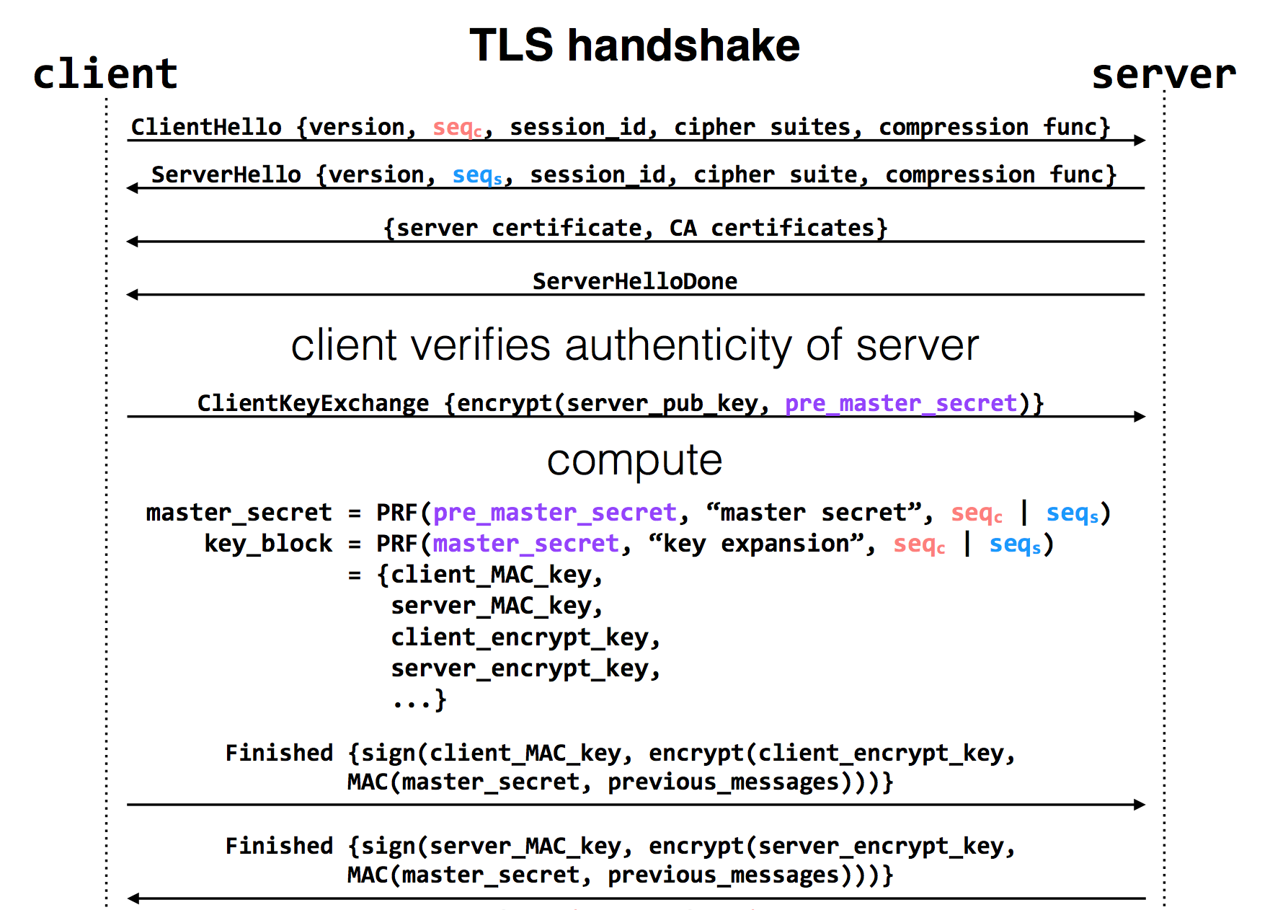
Notes:
pre-master-key is a random number
PRF: pseudo random function
Master key is a 48-byte sequence
https://crypto.stackexchange.com/questions/1139/what-is-the-purpose-of-four-different-secrets-shared-by-client-and-server-in-ssl

Slide 64
Questions on Certificate Authorities
Who should run the certificate authority?
How does the browser get this list of CAs?
Generally they come with the browser
How does the CA build its table of names <-> public keys?
Have to agree on how to name principals, and
Need a mechanism to check that a key corresponds to a name
What if a CA makes a mistake?
Need a way to revoke certificates: Expiration date? Not useful for immediate problems
Publish certificate revocation list? Works in theory, not as well in practice
Query online server to check certificate freshness? Not a bad idea
Notes:
Alternative: avoid CAs by using public keys as names (protocols: SPKI/SDSI)
Works well for names that users do not have to remember/enter

